Slide 1
Deep Learning from Scratch
Theory + Practical
FAHAD HUSSAIN
MCS, MSCS, DAE(CIT)
Computer Science Instructor of well known international Center
Also, Machine Learning and Deep learning Practitioner
For further assistance, code and slide https://fahadhussaincs.blogspot.com/
YouTube Channel : https://www.youtube.com/fahadhussaintutorial

Slide 2
Mini Batch gradient descent
Mini-batch gradient descent is a variation of the gradient descent algorithm that splits the training dataset into small batches that are used to calculate model error and update model coefficients.
Implementations may choose to sum the gradient over the mini-batch which further reduces the variance of the gradient.
Mini-batch gradient descent seeks to find a balance between the robustness of stochastic gradient descent and the efficiency of batch gradient descent. It is the most common implementation of gradient descent used in the field of deep learning.
For further assistance, code and slide https://fahadhussaincs.blogspot.com/
YouTube Channel : https://www.youtube.com/fahadhussaintutorial

Slide 3
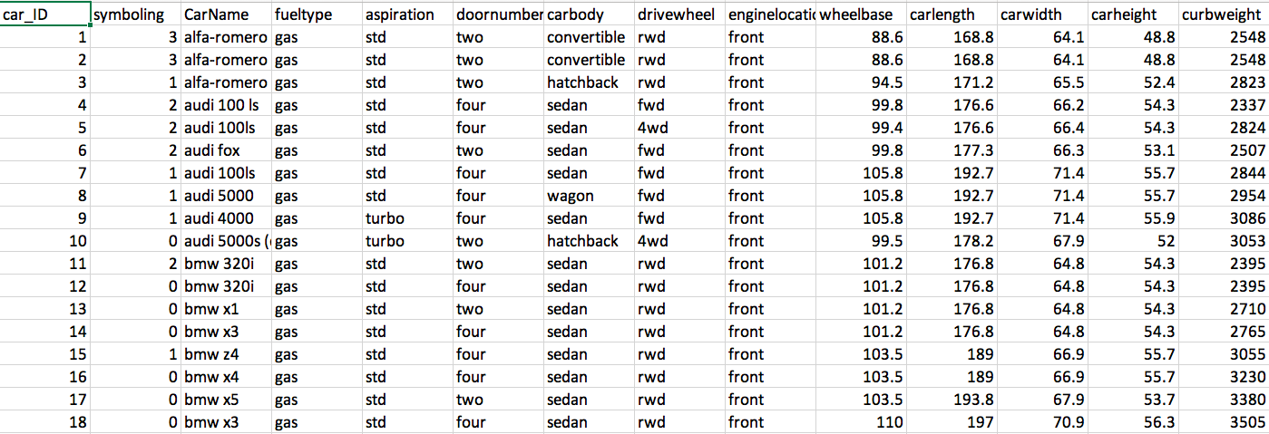
Mini Batch gradient descent
BGD SGD MBGD
For further assistance, code and slide https://fahadhussaincs.blogspot.com/
YouTube Channel : https://www.youtube.com/fahadhussaintutorial

Slide 4
Thank You!
For further assistance, code and slide https://fahadhussaincs.blogspot.com/
YouTube Channel : https://www.youtube.com/fahadhussaintutorial

